Slide 1
SWE 4101
Web and other emerging technologies
Lec - 7
Based on: Books and various web resources…

Slide 2
Web Technologies
Refers to the various tools and techniques that are utilized in the process of communication between different types of devices over the Internet.
Web Technology can be classified into the following sections:
  World Wide Web (WWW): The World Wide Web is based on several different technologies: Web browsers, Hypertext Markup Language (HTML), and Hypertext Transfer Protocol (HTTP).
  Web Browser: The web browser is an application software used to explore the WWW (World Wide Web). It provides an interface between the server and the client and requests web documents and services from the server.
  Web Server: A web server is a program that processes user network requests and serves them with the files required to create web pages. This exchange occurs via Hypertext Transfer Protocol (HTTP).
  Web Pages: A webpage is a digital document linked to the World Wide Web. It is viewable by anyone connected to the internet who has a web browser.
  Web Development: This refers to the building, creating, and maintaining of websites. It includes aspects such as web design, web publishing, web programming, and database management. Ultimately, it is the creation of applications, such as websites, that work over the internet.

Slide 3
The Web
The World Wide Web (WWW) is a system of interlinked hypertext documents and multimedia resources accessed via the internet using web browsers.
Invented by: Sir Tim Berners-Lee in 1989 at CERN.
Core Technologies:
  HTML (HyperText Markup Language) – structures web content
  HTTP/HTTPS (HyperText Transfer Protocol) – governs data communication
  URLs (Uniform Resource Locators) – unique addresses for web resources
The Web is not the internet—it’s a service that runs on top of the internet.

Slide 4
How the Web Works
Basic Workflow:
  User types a URL in a browser
  Browser sends an HTTP request to a web server
  Server responds with HTML, images, etc.
  Browser renders the page for the user
Client-Server Model:
  Client: Your device (browser)
  Server: Hosts website files
Global Impact:
  Revolutionized communication, education, commerce, and entertainment
  Enabled social media, e-commerce, cloud computing, and open access to information
The first website (info.cern.ch) is still live!

Slide 5
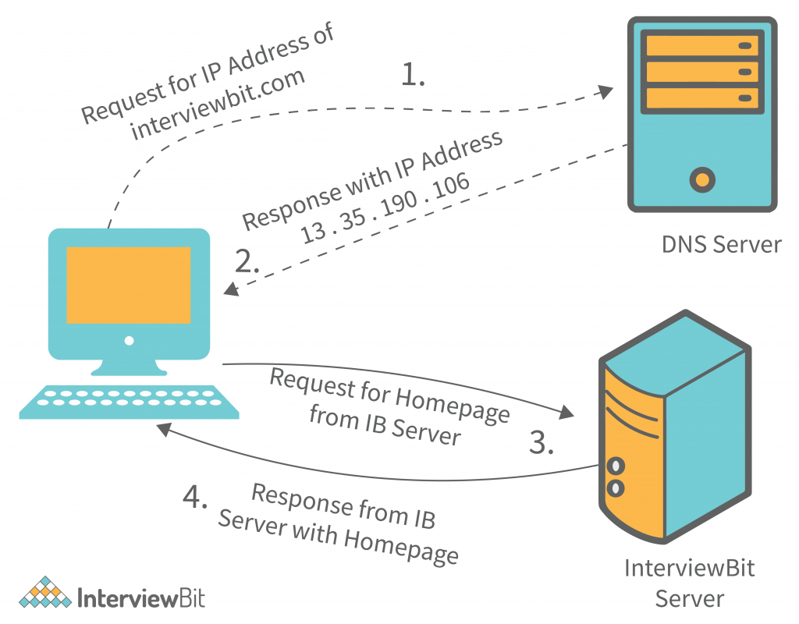
Client-Server Model
A network architecture where tasks or workloads are divided between:
  Client: Requests services or resources
  Server: Provides services or resources

Slide 6
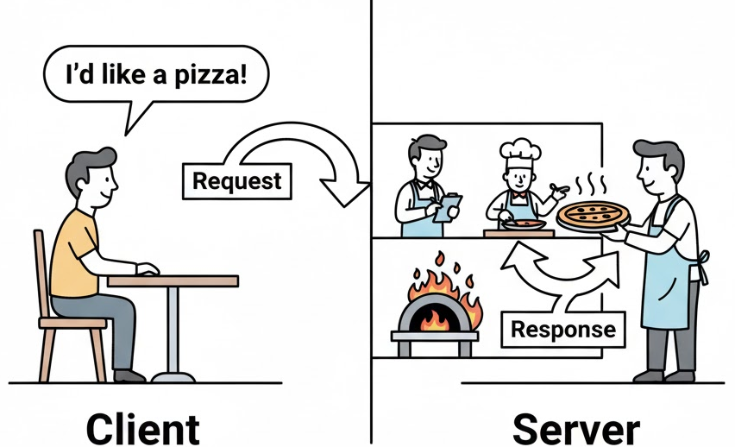
Client-Server Model
Like Ordering Food at a Restaurant
Client = Customer
    → Looks at the menu and places an order
Server = Waiter + Kitchen
    → Takes the order (request), prepares food (processes), and delivers the meal (response)
Menu = Available Services (e.g., web pages, files, data)

Slide 7
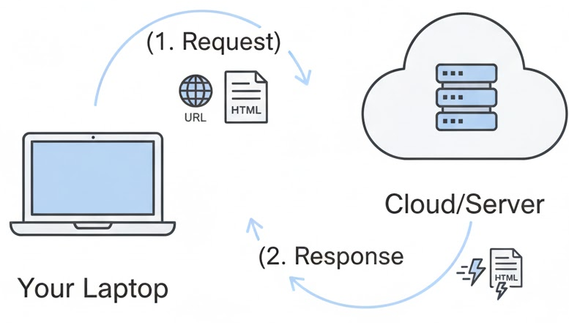
Client-Server Model
What Happens When You Visit example.com?
  You type https://example.com in your browser (client)
  Browser sends an HTTP request to the web server
  Server finds the HTML/CSS/JS files
  Server sends back the files via HTTP response
  Browser renders the webpage for you

Slide 8
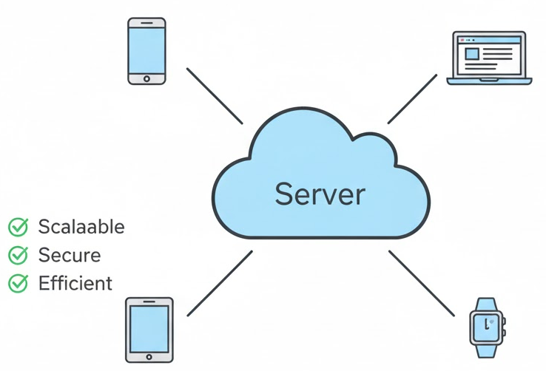
Why the Client-Server Model Matters
Centralized Control: Servers manage data securely (e.g., your Gmail emails live on Google’s servers)
Scalability: One server can handle thousands of clients (e.g., Netflix serves millions)
Efficiency: Clients don’t need huge storage—just a way to ask
Reliability: Servers are always online, backed up, and maintained
Used everywhere: Web apps, online games, banking, IoT devices

Slide 9
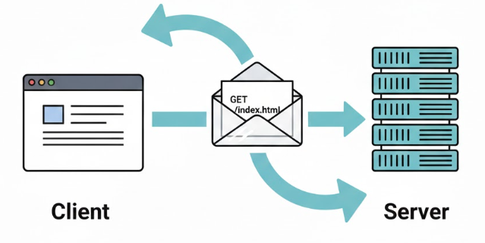
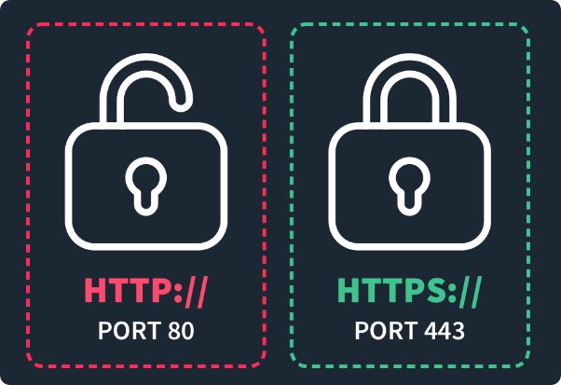

HTTP:The Language of the Web
HTTP = Hyper-Text Transfer Protocol
It’s the foundation for communication between web browsers (clients) and servers
Used to request and deliver web pages, images, videos, and data
Operates on port 80 by default
Not encrypted → data travels in plain text

Slide 10
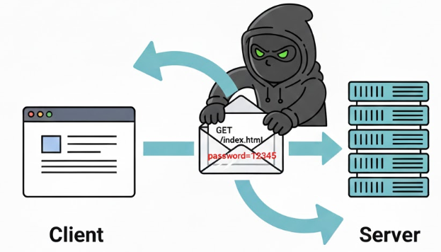
The Problem with HTTP
⚠️ Why HTTP Isn’t Safe
All data is sent in plain text
Anyone on the network (e.g., hackers on public Wi-Fi) can:
  Read your messages
  Steal passwords, credit card numbers, or session cookies
  Modify content (e.g., inject ads or malware)
Real Risk: Logging into a bank over HTTP = shouting your password in a crowded room.

Slide 11
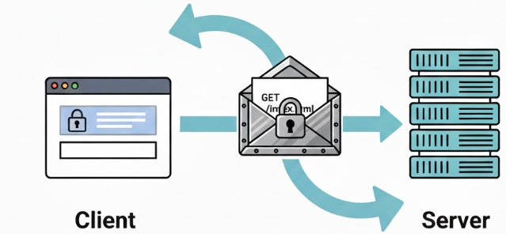

Solution: HTTPS
🔒 HTTPS: HTTP + Security
HTTPS = HTTP Secure
Adds a security layer using SSL/TLS encryption
Encrypts all data between client and server
Uses port 443 by default
Ensures:
  Confidentiality (no one can read your data)
  Integrity (data can’t be altered)
  Authentication (you’re talking to the real website)

Slide 12
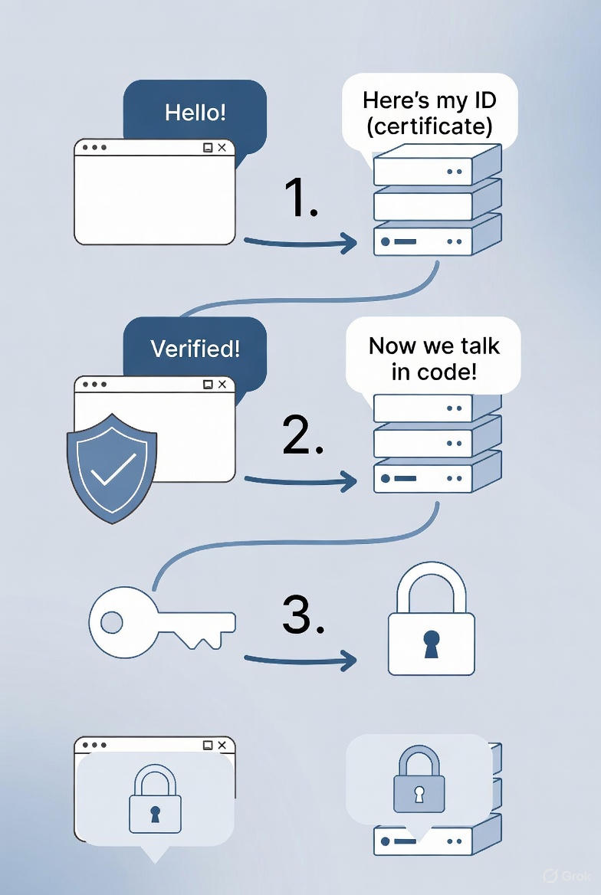
How HTTPS Works
The HTTPS Handshake
Browser asks: “Can we talk securely?”
Server sends its digital certificate (includes public key)
Browser verifies the certificate with a trusted authority (e.g., Let’s Encrypt)
They agree on a secret encryption key
All future messages are encrypted with that key

Slide 13



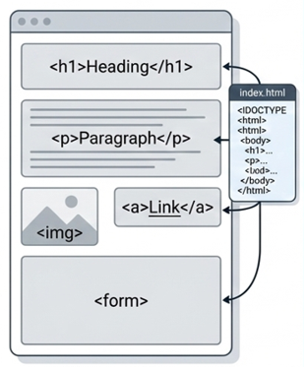
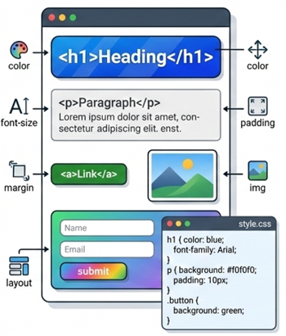
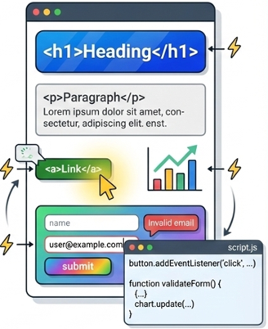
Web Development
They primarily revolve around three core components:
Defines content & Structure using tags
Control visual appearance: color font, etc.
Adds Dynamic behavior: Animation, update, validation…

Slide 14
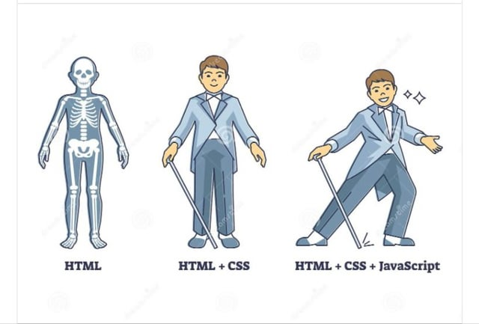
Web Development

Slide 15

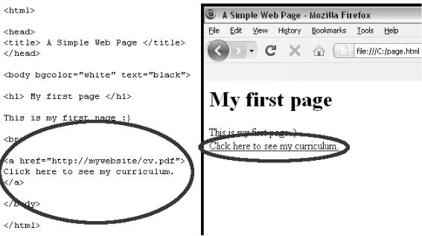
What is HTML?
HTML stands for Hyper-Text Markup Language
It’s not a programming language—it’s a markup language used to structure content on the web
Browsers read HTML and render it as visible web pages
Created by Tim Berners-Lee in 1991
File extension: .html or .htm
Current version: HTML5 (the latest standard with enhanced features)

Slide 16
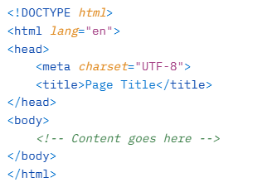
Anatomy of an HTML Page
Every HTML document starts with <!DOCTYPE html>
Root element: <html>
Two main sections:
  <head>: Contains meta information (title, links to CSS, etc.)
  <body>: Contains visible content
Example Skeleton:

Slide 17
Understanding Tags and Elements
Tags are enclosed in angle brackets: <tagname>
Most tags come in pairs: opening <p> and closing </p>
Content goes between tags: <p>This is a paragraph.</p>
Some are self-closing (empty): <img src="image.jpg" /> or <br />
Attributes provide extra info: <a href="https://example.com">Link</a>
Common Examples:
Headings: <h1> to <h6>
Paragraph: <p>
Link: <a href="...">
Image: <img src="..." alt="...">

Slide 18
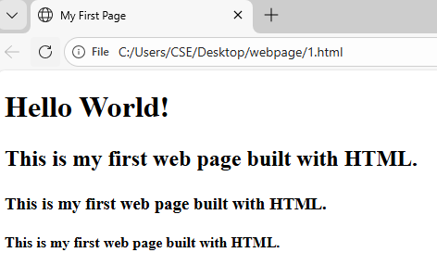
Your First Simple HTML Page
Open Notepad and write your code…
    <!DOCTYPE html>
    <html lang="en">
    <head>
    <meta charset="UTF-8">
    <title>My First Page</title>
    </head>
    <body>
      <h1>Hello World!</h1>
      <h2><p>This is my first web page built with HTML.</p></h2>
      <h3><p>This is my first web page built with HTML.</p></h3>
      <h4><p>This is my first web page built with HTML.</p></h4>
    </body>
    </html>
Save as .html file and open in browser

Slide 19
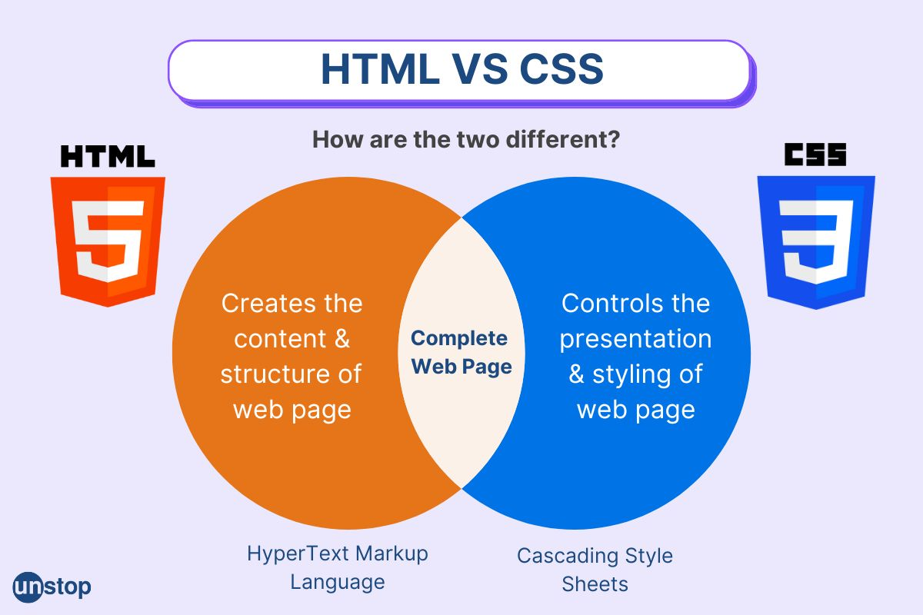
What is CSS?
CSS stands for Cascading Style Sheets
It is used to style and layout web pages (colors, fonts, spacing, etc.)
CSS controls the presentation, while HTML handles the structure
Separates content from design → easier maintenance and better accessibility
Current version: CSS3 (with ongoing updates)

Slide 20
Common CSS Properties
Text: color, font-family, font-size, text-align
Background: background-color, background-image
Layout: margin, padding, display, width, height
Example
body {
font-family: Arial, sans-serif;
background-color: #f0f0f0;
color: #333;
margin: 0;
}
h1 {
color: #0066cc;
text-align: center;
}
p {
font-size: 16px;
line-height: 1.5;
}

Slide 21
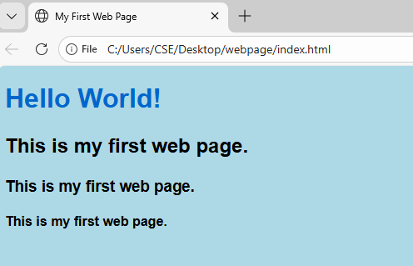

Connecting CSS with HTML
Create another file in the same folder where you have stored the .html file
Name it: style.css
Open you .html file. This time it will load with the css content
style.css
body {
background-color: lightblue;
font-family: Arial, sans-serif;
text-align: left;
}
h1 {
color: #0066cc;
}
p {
color: black;
}
Update your .html file like below

Slide 22
What is JavaScript?
JavaScript (JS) makes your web page interactive.
HTML → structure
CSS → design
JavaScript → behavior (clicks, alerts, logic, animation)
Example: button click, form validation, pop-up message.

Slide 23
How to add JavaScript to HTML
Method 1: Inline JavaScript (NOT recommended for big projects)
<button onclick="alert('Hello!')">Click Me</button>
Method 2: Internal JavaScript (inside <script> tag)
<!DOCTYPE html>
<html>
<head>
<title>JS Test</title>
</head>
<body>
<button onclick="sayHello()">Click Me</button>
<script>
function sayHello() {
alert("Hello from JavaScript!");
}
</script>
</body>
</html>

Slide 24
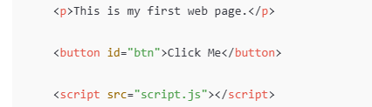
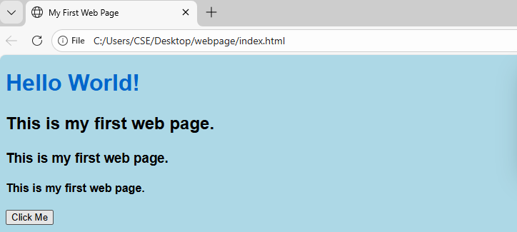
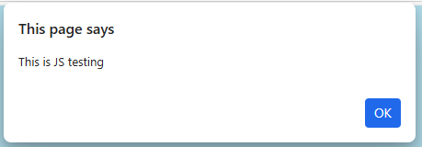
How to add JavaScript to HTML
Method 3: External JavaScript (BEST practice)
Create another file in the same folder where you have stored the .html file
Name as script.js
Now you need to modify the .html file to link with .js file.
document.getElementById("btn").onclick = function () {
alert("This is JS testing");
};
Load your .html file..

Slide 25
Recent Trends in Computing

Slide 26
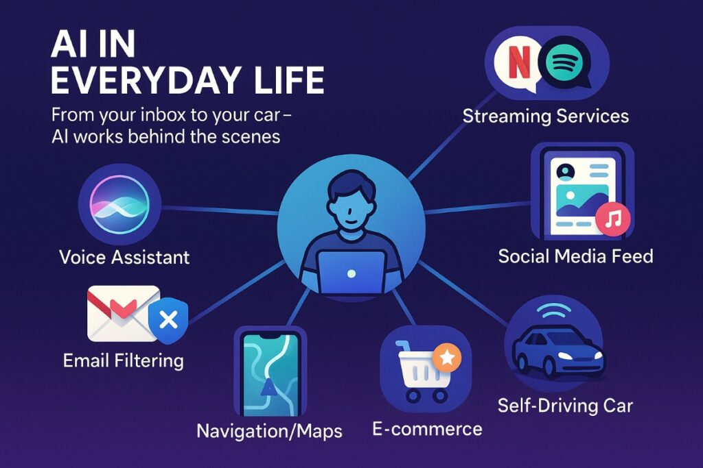
Artificial Intelligence (AI)
Computers that can think, learn, and make decisions like humans
It's like giving a brain to machines!
Not magic – just smart programs
Siri understands your voice and answers questions
Netflix suggests movies you’ll love

Slide 27
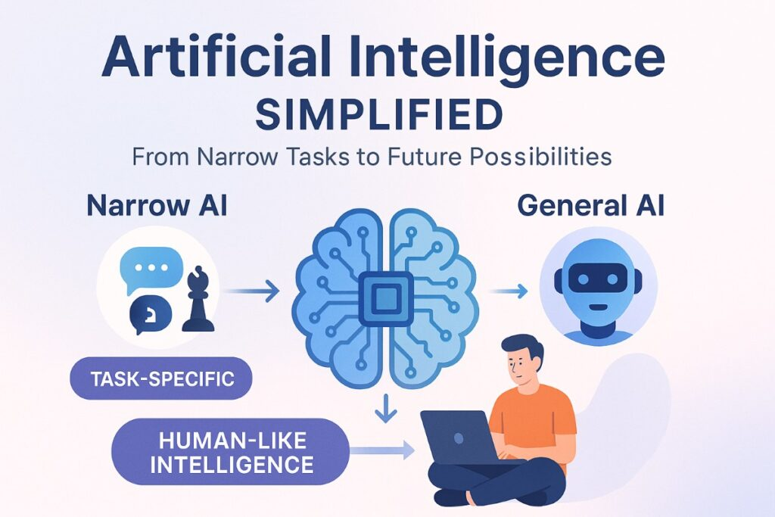
Artificial Intelligence (AI)
Why is AI Useful?

Slide 28
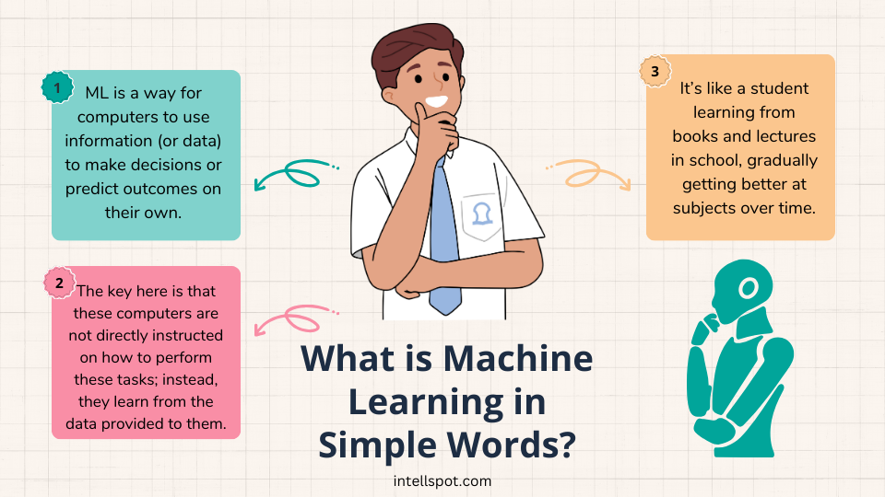
Machine Learning (ML)
Systems that improve automatically by learning from data
Like a baby learning from experience – no one programs every rule!
Your email automatically puts spam in the junk folder

Slide 29
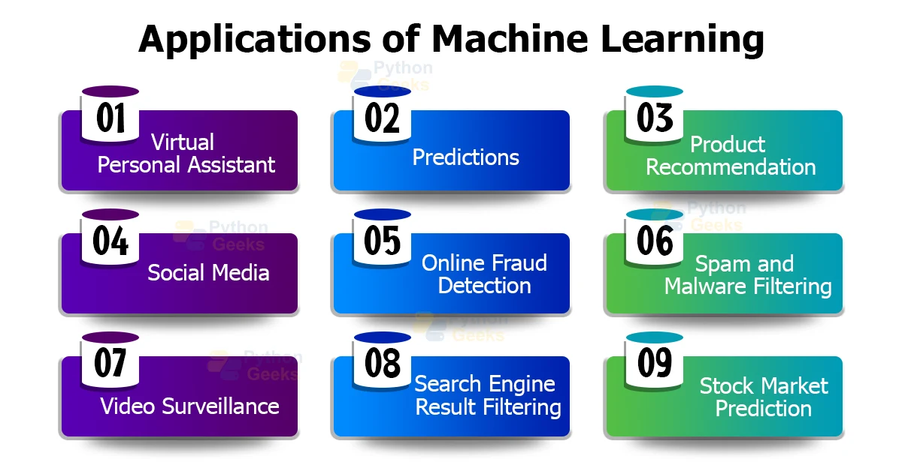
Machine Learning (ML)
How Does It Work?
You give it lots of examples (data)
It finds patterns and gets better over time
Used in YouTube recommendations and fraud detection in banks

Slide 30
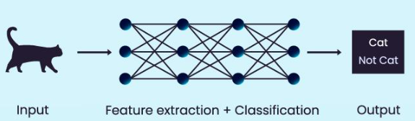
Deep Learning (DL)
Advanced ML using "neural networks" (inspired by the human brain)
Great for images, speech, and text
Face unlock on your phone
Alexa or Google Assistant understands your voice
Learns from millions of examples super fast
Powers self-driving cars to "see" the road
Helps translate languages instantly

Slide 31
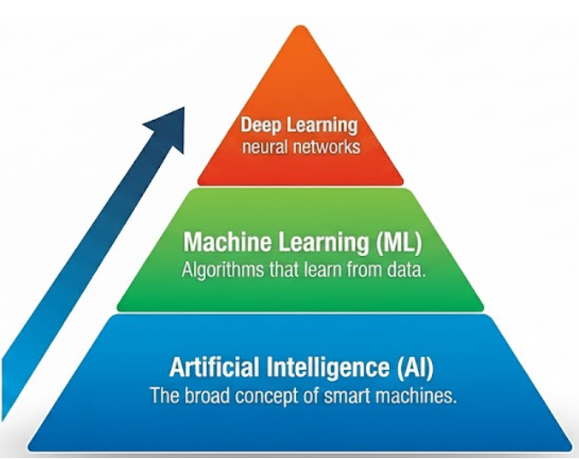

Relationship Between AI, ML, and DL

Slide 32
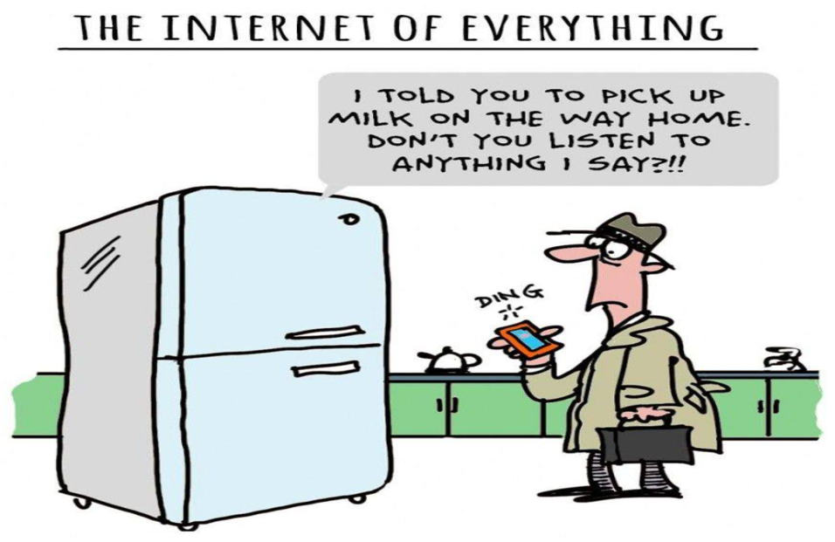
Internet of Things (IoT)
    The IoT is a global infrastructure for the information society, enabling advanced services by interconnecting (physical and virtual) things based on existing and evolving interoperable information and communication technologies.

Slide 33
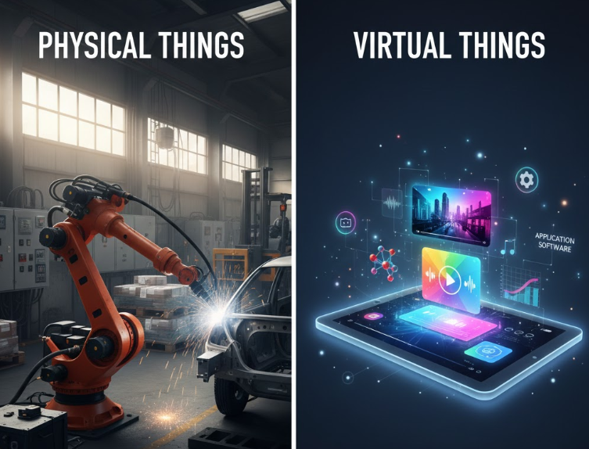
Internet of Things (IoT)
Physical things exist in the physical world and are capable of being sensed, actuated and connected. Examples of physical things include the surrounding environment, industrial robots, goods and electrical equipment.
Virtual things exist in the information world and are capable of being stored, processed and accessed. Examples of virtual things include multimedia content and application software.

Slide 34
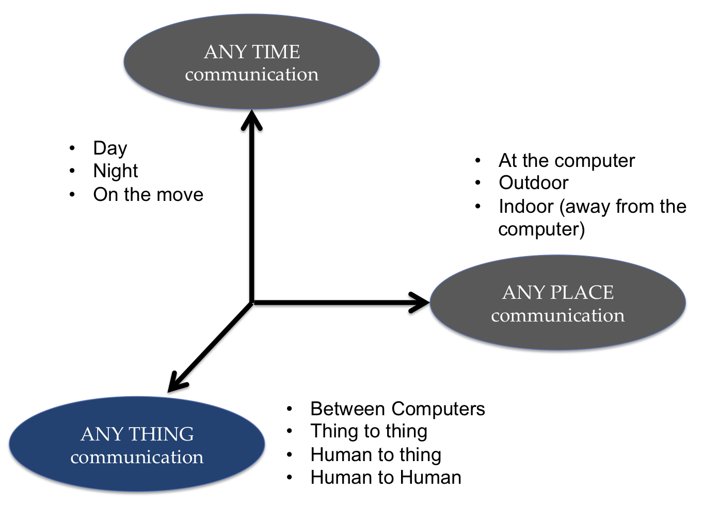
Internet of Things (IoT)

Slide 35
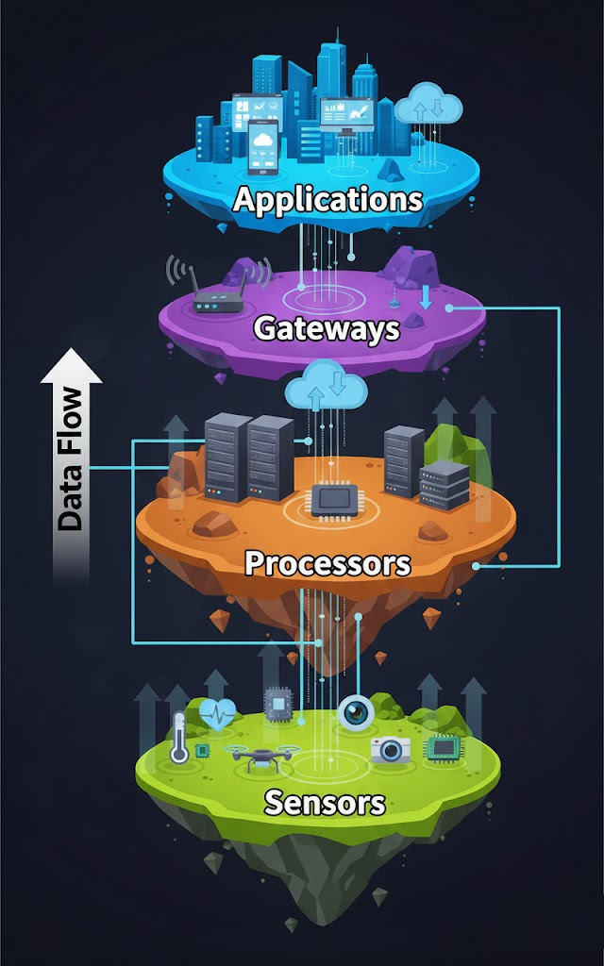
Internet of Things (IoT)
BUILDING BLOCKS of IoT
Applications are the user-facing part of an IoT system.
They use cloud-based platforms to analyze data and provide meaningful services.
Users control them and deliver services like home automation, security systems, and industrial control.
Gateways are responsible for routing the processed data and send it to proper locations for its (data) proper utilization.
Network connectivity is essential for any IoT system to communicate.
LAN, WAN, PAN, etc are examples of network gateways.
Processors are the brain of an IoT system.
They process sensor data in real time, extract useful information, and secure data through encryption and decryption.
They are found in embedded devices and microcontrollers.
Sensors or devices collect real-time data from the environment.
Each device has a unique IP address for identification on a network.
They are active devices and can work automatically or be user-controlled.
Examples: gas sensor, water quality sensor, moisture sensor.

Slide 36
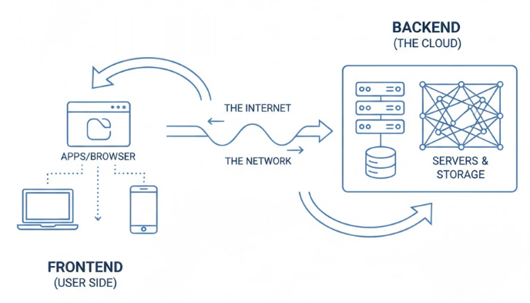
Cloud Computing
Cloud computing is the delivery of computing services like storage, servers, databases, software, and networking over the internet instead of using a local computer or server.
Example: Google Drive, Gmail, Dropbox
The High-Level Architecture
Frontend: Your device (laptop, phone, tablet) and apps or browsers you use to access the cloud.
Backend: The cloud’s data centers with servers, storage, and networking hardware.
Network: The Internet connects the frontend and backend, sending requests and results.

Slide 37
Cloud Computing
How it works
Request: You perform an action on your device (e.g., clicking "Play" on a movie or saving a document).
Transmission: Your request travels over the internet to the cloud provider's data center.
Processing (The "Brain"): A Central Server manages the system. It uses software called Middleware to ensure everything runs smoothly. It allocates the necessary processing power or storage space to your specific task.
Virtualization: This is the "secret sauce" of the cloud. Instead of giving you one whole physical server, the cloud uses a Hypervisor to split one physical server into many "Virtual Machines." This allows thousands of people to share the same hardware simultaneously without seeing each other's data.
Delivery: The requested data or completed task is sent back to your device instantly.

Slide 38
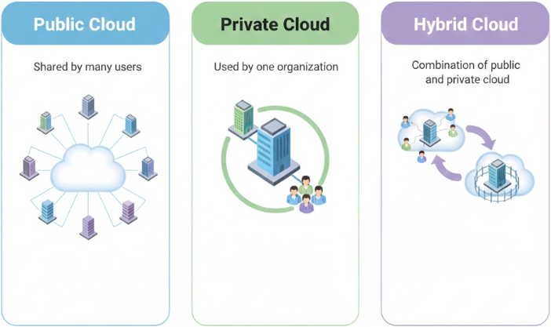
Cloud Computing

Slide 39

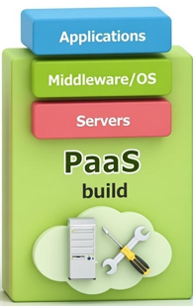

Cloud Computing
Types of Cloud Services
Infrastructure as a Service (IaaS)
  Provides virtual servers, storage, and networks.
  User manages OS and applications.
  Example: Amazon EC2, Google Compute Engine
Platform as a Service (PaaS)
  Provides a platform to develop and run applications
  No need to manage hardware or OS
  Example: Google App Engine
Software as a Service (SaaS)
  Provides ready-to-use software over the internet
  Example: Gmail, Microsoft 365, Zoom

Slide 40
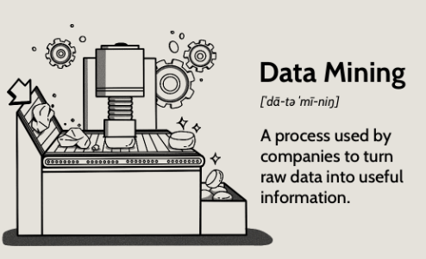
Data Mining

Slide 41
Data to Deal with
How much data to deal with???
The amount of data in the world was estimated to be 44 zettabytes at the beginning of 2020.
By 2025, the amount of data generated each day will reach 463 exabytes globally.
Google, Facebook, Microsoft, and Amazon store at least 1,200 petabytes of information.
In 2020, roughly 306.4 billion emails & 18.7 billion text messages were sent and received each day
Four petabytes is the estimated amount of new data being generated by Facebook daily.
Almost 5 billion videos on Youtube are watched every day.
Tera- means 1,000,000,000,000;
Peta- means 1,000,000,000,000,000;
Exa- means 1,000,000,000,000,000,000;
Zetta- means 1,000,000,000,000,000,000,000;
Yotta- means 1,000,000,000,000,000,000,000,000;

Slide 42
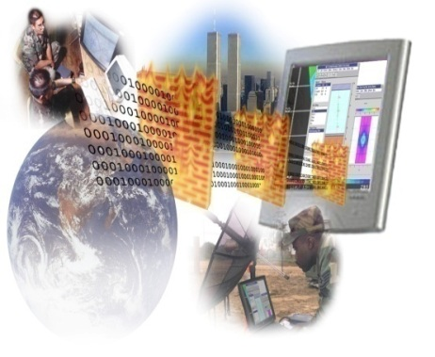

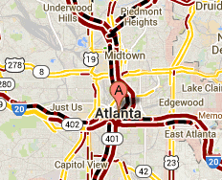
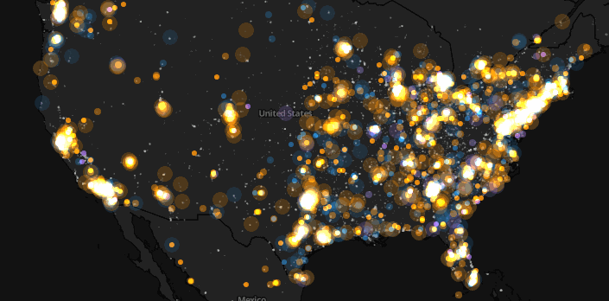
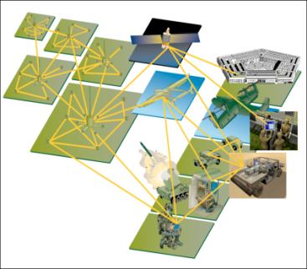
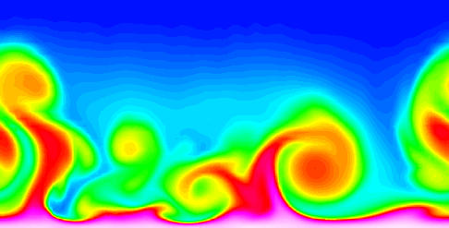
Large-scale Data is Everywhere!
E-Commerce
Cyber Security
There has been enormous data growth in both commercial and scientific databases due to advances in data generation and collection technologies
Traffic Patterns
Social Networking: Twitter
Sensor Networks
Computational Simulations

Slide 43
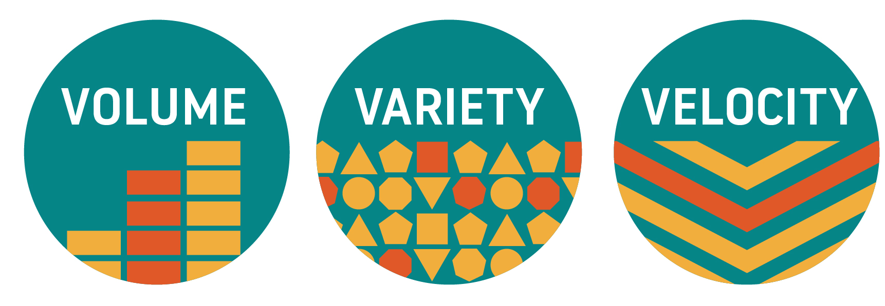
What Makes Data Complex

Slide 44




Why Data Mining? Commercial Viewpoint
Lots of data is being collected and warehoused
  Web data
    Google has Peta Bytes of web data
    Facebook has billions of active users
  purchases at department/ grocery stores, e-commerce
    Amazon handles millions of visits/day
  Bank/Credit Card transactions
Computers have become cheaper and more powerful
Competitive Pressure is Strong
  Provide better, customized services for an edge (e.g. in Customer Relationship Management)

Slide 45
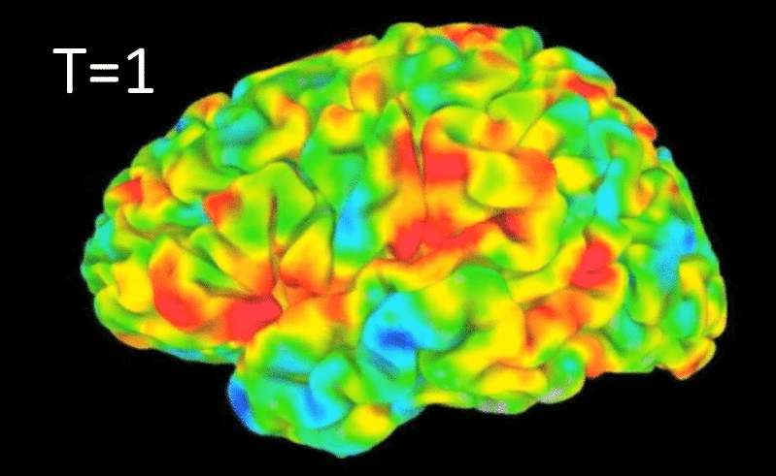
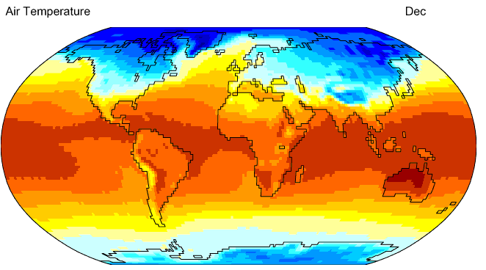
Why Data Mining? Scientific Viewpoint
Data collected and stored at enormous speeds
  remote sensors on a satellite
    NASA EOSDIS archives over
    petabytes of earth science data / year
  telescopes scanning the skies
    Sky survey data
  High-throughput biological data
  scientific simulations
    terabytes of data generated in a few hours
Data mining helps scientists
  in automated analysis of massive datasets
  In hypothesis formation
fMRI Data from Brain
Sky Survey Data
Gene Expression Data
Surface Temperature of Earth
45

Slide 46
Data Mining
                Data mining (knowledge discovery from data)
                Extraction of interesting (non-trivial, implicit, previously unknown and potentially useful) patterns or knowledge from huge amount of data
  Data mining: a misnomer?
Alternative names
    Knowledge discovery (mining) in databases (KDD), knowledge extraction, data/pattern analysis, data archeology, data dredging, information harvesting, business intelligence, etc.
Watch out: Is everything “data mining”?
  Simple search and query processing

Slide 47
Knowledge Discovery (KDD) Process
Knowledge
This is a view from typical database systems and data warehousing communities
Data mining plays an essential role in the knowledge discovery process
Pattern Evaluation
Data Mining
Task-relevant Data
Data Warehouse
Selection
Data Cleaning
Data Integration
Databases

Slide 48
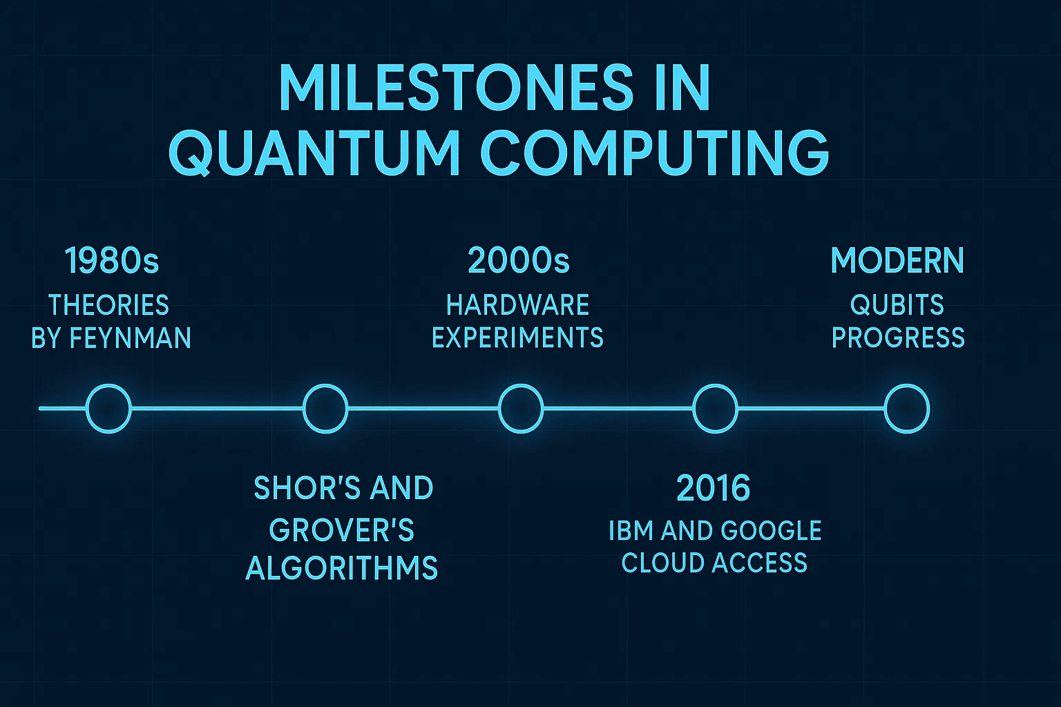
Quantum Computing
Ultra-fast computing using quantum mechanics (tiny particle rules)
Solves problems normal computers can't in years
Breaks complex codes instantly
Improves weather prediction and traffic
Can find the best medicine in seconds instead of years

Slide 49
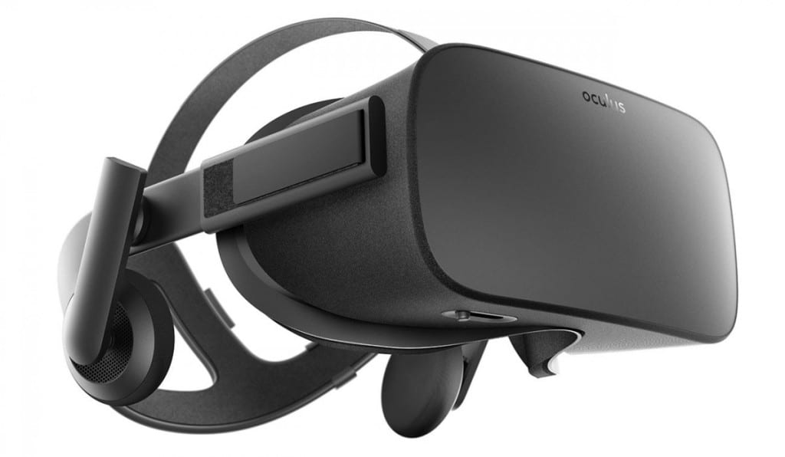
Virtual Reality (VR)
Fully computer-generated immersive environments
Put on a headset and step into a new world!
Example: Oculus headset: Play games where you’re inside the action
Exciting Applications:
Training pilots or doctors safely
Virtual travel to anywhere
Amazing movies and concerts

Slide 50
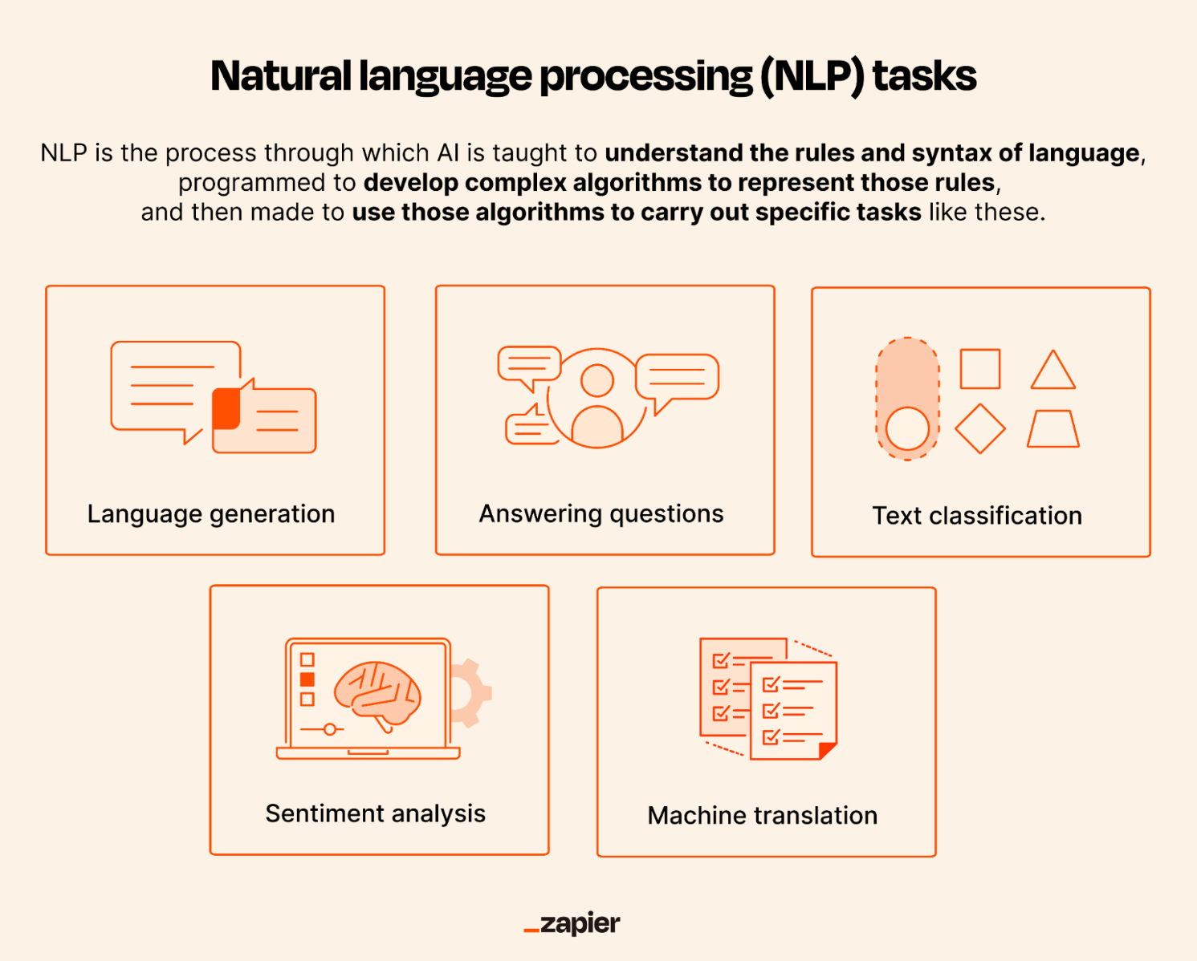
Natural Language Processing (NLP)
Helps computers understand and respond to human language
Like teaching machines to chat naturally!
Example:
ChatGPT answers your questions
Google Translate changes languages instantly

Slide 51
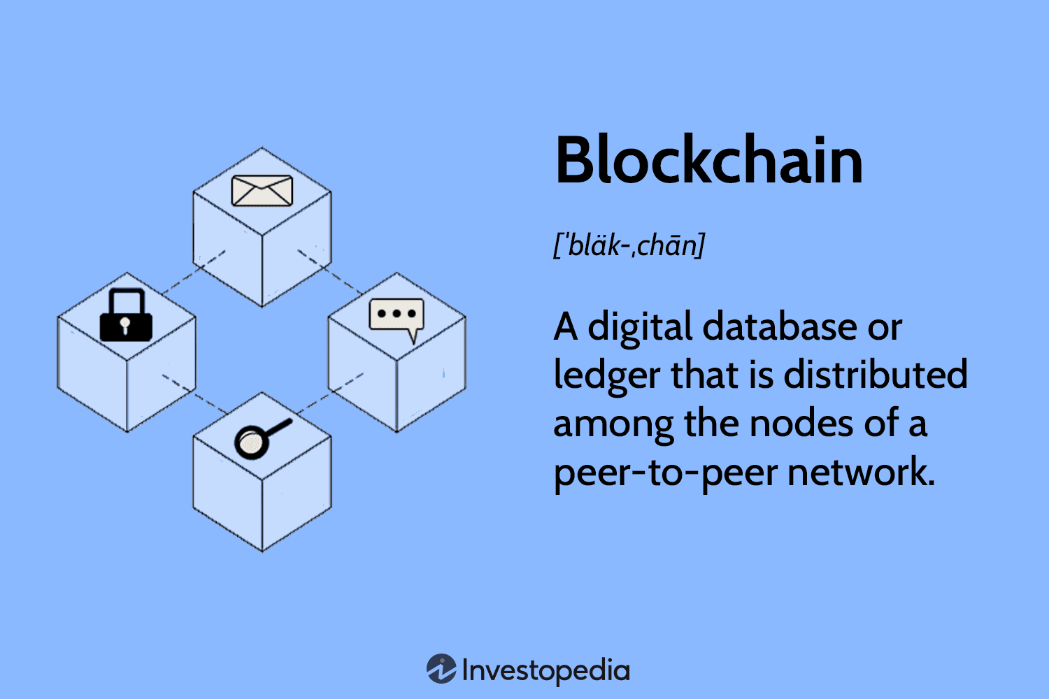
Blockchain
Blockchain is a digital ledger that records transactions securely and transparently.
It’s called a “chain” because each record, called a block, is linked to the previous one.
Key Features
Decentralized: No single authority controls it.
Transparent: Anyone in the network can see the transactions.
Secure: Uses cryptography to prevent tampering.
Immutable: Records cannot be altered once added.

Slide 52
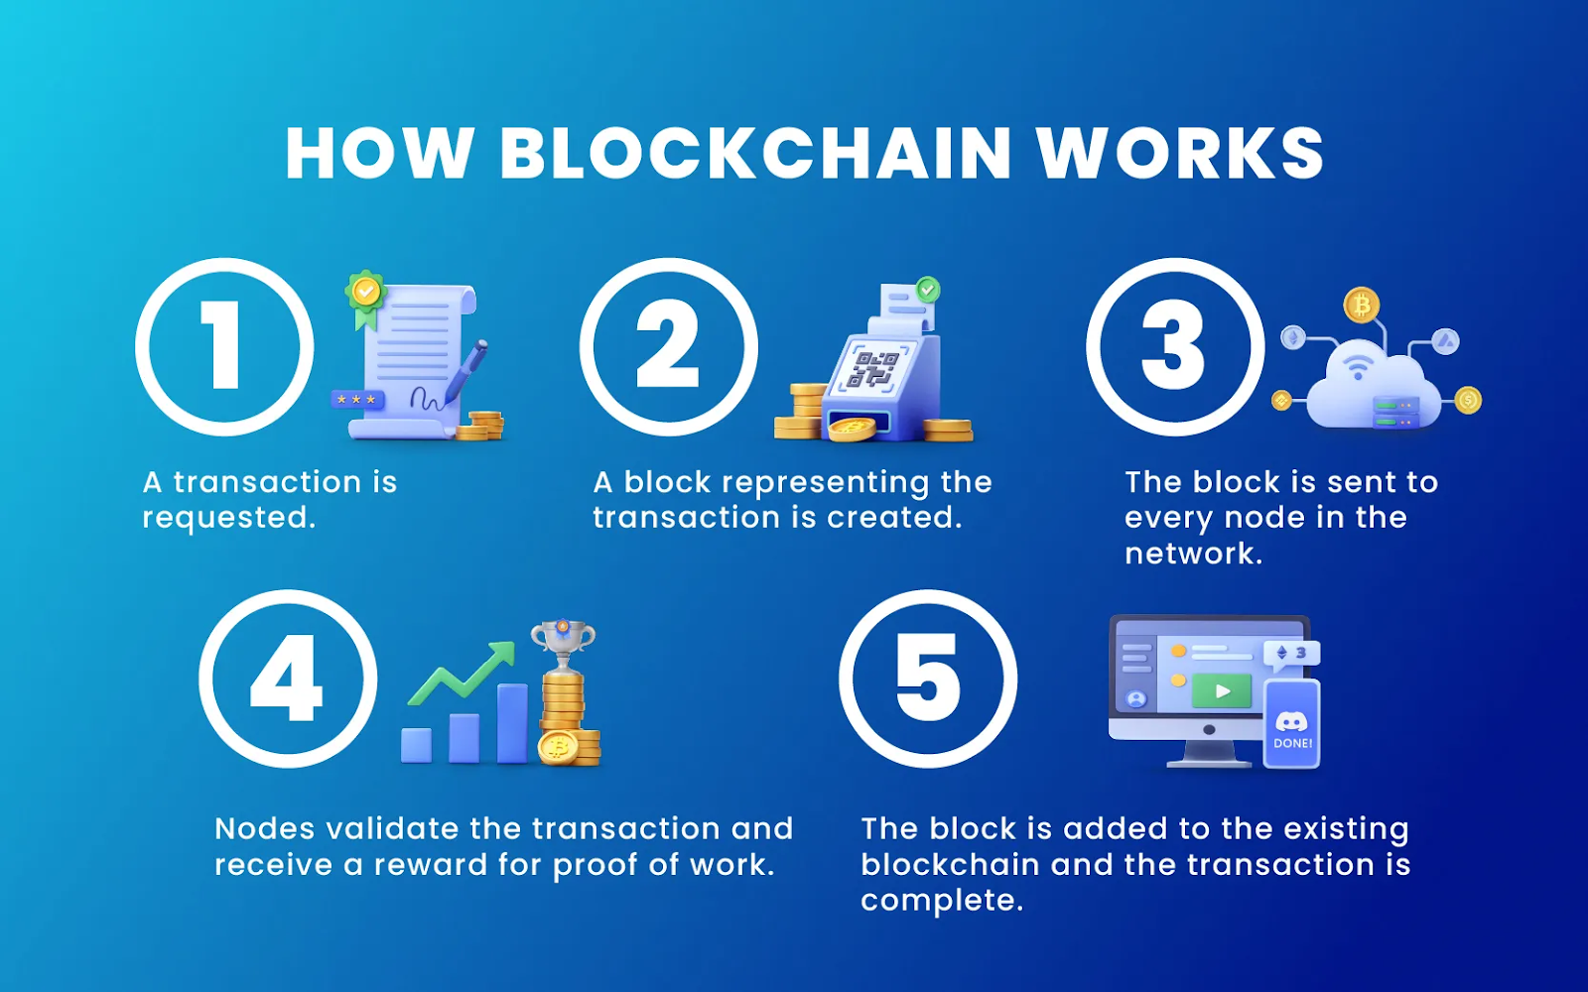
Blockchain

Slide 53
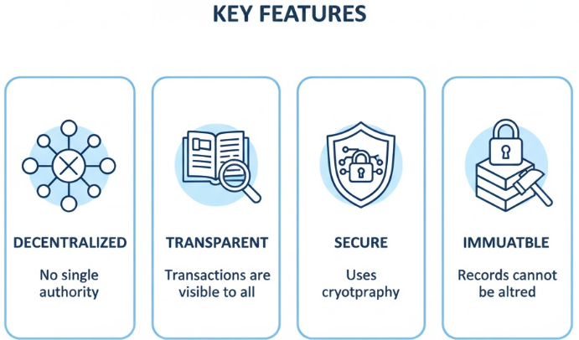
Blockchain

Slide 54
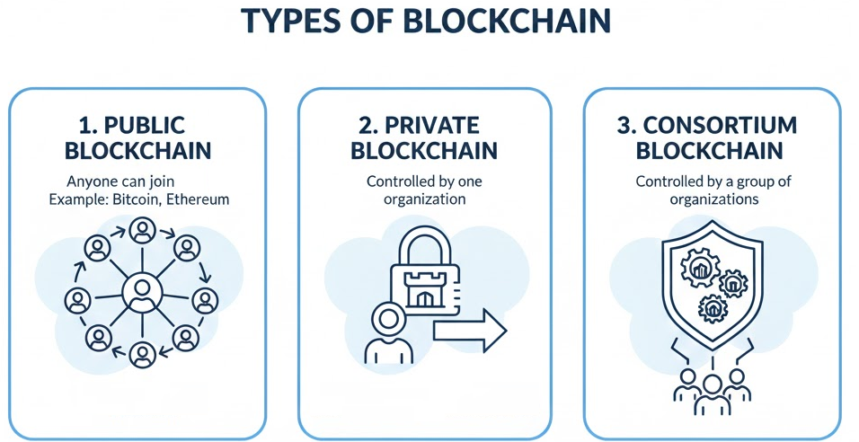
Blockchain

